Slide 1
The basics of PCA
Combining variables
PCA –basics
Its applications

Slide 2
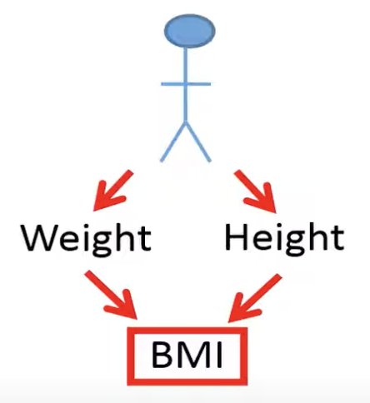
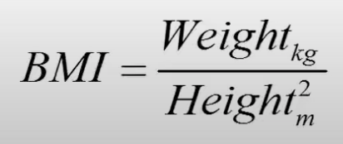
Combining variables
Cholesterol = Weight + Height
Cholesterol = BMI
Notes:
It is common that we like to combine variables in order to simplify the analysis. For example, if we have measurements of weight and height of some individuals, we can combine these two variables into one variable, the body mass index (BMI). The BMI is calculated based on a person’s body weight in kilograms divided by the square of the body height in meters. For example, of we like to predict the cholesterol level based on a person’s weight and height by using linear regression. However, remember that it could be problematic in linear regression if there is too strong correlation between the explanatory variables, which is called multicollinearity. Also, the more explanatory variables we have in our model, the more measurement we need to do. Thus, the sample size generally needs to be bigger for models including more explanatory variables. This is one of the reasons why it makes sense to combine weight and height into just one variable, the body mass index. We can then predict the cholesterol level with just one variable that contains information on both weight and height.

Slide 3
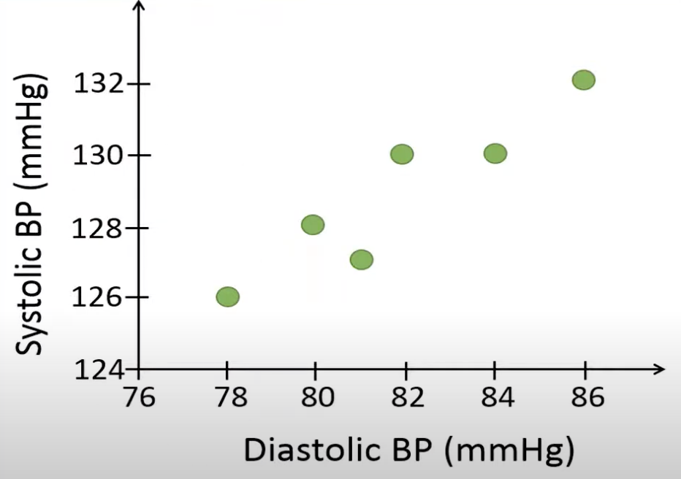
Combining variables
Diastolic BP | Systolic BP
78 | 126
80 | 128
81 | 127
82 | 130
84 | 130
86 | 132
Notes:
For example, we measure the upper and lower blood pressure of six individuals. Person number 1 has a diastolic blood pressure of 78 and a systolic blood pressure of 126, person number 2 has a diastolic blood pressure of 80 and a systolic blood pressure of 128 and so on.
For this dataset, there seems to be a strong positive correlation between the upper and lower blood pressure. If a person has a high systolic blood pressure, it is likely that the person also has a high diastolic blood pressure.
Note that, PCA will be more useful when the variables are strongly correlated, because the combined variable will contain more information of the variables compared to the variables show a weak correlation to each other.

Slide 4
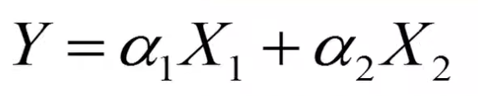

Combining variables
Diastolic BP | Systolic BP
78 | 126
80 | 128
81 | 127
82 | 130
84 | 130
86 | 132
X1 and X2: two variables to combine
Y: the combined variable
$$α1, α2:weights (loadings)$$
BP = 0.8 DBP + 0.6 SBP
Notes:
Let’s say that we like to combine the upper and lower blood pressure into 1 variable that we simply just call blood pressure (BP). How to combine these two variables in the best way? We could use the following equation to combine the two variables.
For example, if we set alpha 1 is 0.8 and alpha 2 is 0.6 then we put more weight on the diastolic blood pressure than on the systolic blood pressure. This means that the combined variable will be based on more information from the diastolic blood pressure.

Slide 5

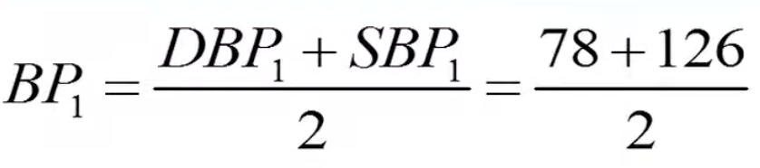
Combining variables
Diastolic BP | Systolic BP
78 | 126
80 | 128
81 | 127
82 | 130
84 | 130
86 | 132
= 102
Notes:
Let’s say we want to combine the two variables by calculating the mean of the measurements for each individual. For example, to calculate the combined blood pressure for person number 1, we add the diastolic and systolic blood pressure and divide by 2 since we have 2 variables in this case.

Slide 6
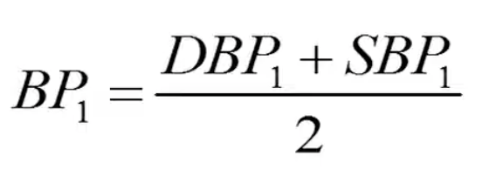
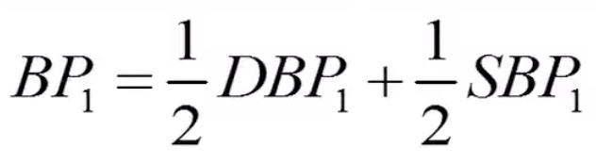
Combining variables
Diastolic BP | Systolic BP | Mean BP
78 | 126 | 102
80 | 128 | 104
81 | 127 | 104
82 | 130 | 106
84 | 130 | 107
86 | 132 | 109
Notes:
We can reformulate this equation by multiplying by ½ before we add the numbers. Thus, when we combine the two variables by using the mean, this can be seen that we use the weights 0.5 for our linear combination. When we use this method, we put equal weights on the two variables when we combine them.

Slide 7

Combining variables
Diastolic BP | Systolic BP | Mean BP | Sum BP
78 | 126 | 102 | 204
80 | 128 | 104 | 208
81 | 127 | 104 | 208
82 | 130 | 106 | 212
84 | 130 | 107 | 214
86 | 132 | 109 | 218
Conclusion: The difference between two methods is the values used for the weights.
Notes:
Another way to combine the variables is to simply sum the two measurements for each person. By using the sum, these values represent our combined variable. When we sum the values, we also use the same basic formula as we used when we combined the variables based on the mean.

Slide 8
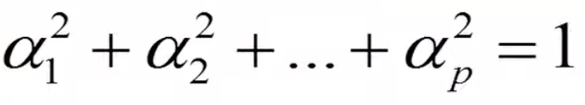
PCA
Principal component analysis (PCA) is a method to find the linear combination that accounts for as much variability as possible
Constraint:
Notes:
In our example, PCA would combine the diastolic blood pressure and the systolic blood pressure in a way so that the combined variables has as much variability as possible. In other words, it will combine the two variables so that we maximize the variance of the combined variable. Therefore, PCA tries to find the optimal values for alpha one and alpha two that maximize the variance of the linear combination. Since one can make the variance larger by simply selecting larger values for the weights, the basic PCA therefore uses the following constraint, where the squared alpha values should sum up to 1

Slide 9
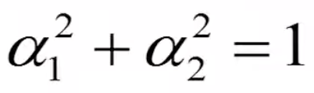
PCA
Constraint:
Notes:
In our example, we want to combine only 2 variables, which means that the square of alpha one plus the square of alpha two should be equal to 1.

Slide 10
PCA
Diastolic BP | Systolic BP | BP
78 | 126 | 138
80 | 128 | 140.8
81 | 127 | 141
82 | 130 | 143.6
84 | 130 | 145.2
86 | 132 | 148
 | Mean = | 142.8
BP = 0.8 DBP + 0.6 SBP
Notes:
Let’s use these weights in order to combine the two variables, by using the linear combination of the two variables with the weights 0.8 and 0.6, the first person has a combined blood pressure of 138. Next we calculate the variance of this combined variable. Therefore, we need to calculate the mean. Remember that the sample variance is calculated as the sum of the squared difference between the individual values and the mean, divided by the sample size minus 1. In this case, the variance of the combined variables is 12.74

Slide 11
PCA
Alpha1 | Alpha2 | var(Y)
0.8 | 0.6 | 12.74
0.6 | 0.8 | 11.8
0.98 | 0.2 | 10.4
0.2 | 0.98 | 7.4
Conclusion: We would select the weights 0.8 and 0.6 when we combine the diastolic and systolic blood pressures because these weights generate maximal variance of the combined variables.
Notes:
Let’s try different weights for the linear combination to see which combination that results in the maximum variance of the combined variable. If we flip the values of the weights, so that we put more weight on the systolic pressure, the variance is reduced to 11.8. This indicate that we should put more weight on the diastolic blood pressure to maximize the variance. Let’s put a lot of weight on the diastolic pressure with the weights 0.98 and 0.2. the sum of these squared weights is approximately equal to 1. By putting too much weight on the diastolic pressure, we reduce the variance of the combined variable to 10.4. Finally, we test to put a lot of weight on the systolic blood pressure instead. These weights result in the lowest variance of the combined variable out of all weights we have tried so far.
So why is it so important to maximize the variance? We can see variance as information. Thus, when we combine variables, we like to keep as much information as possible in the combined variable.

Slide 12
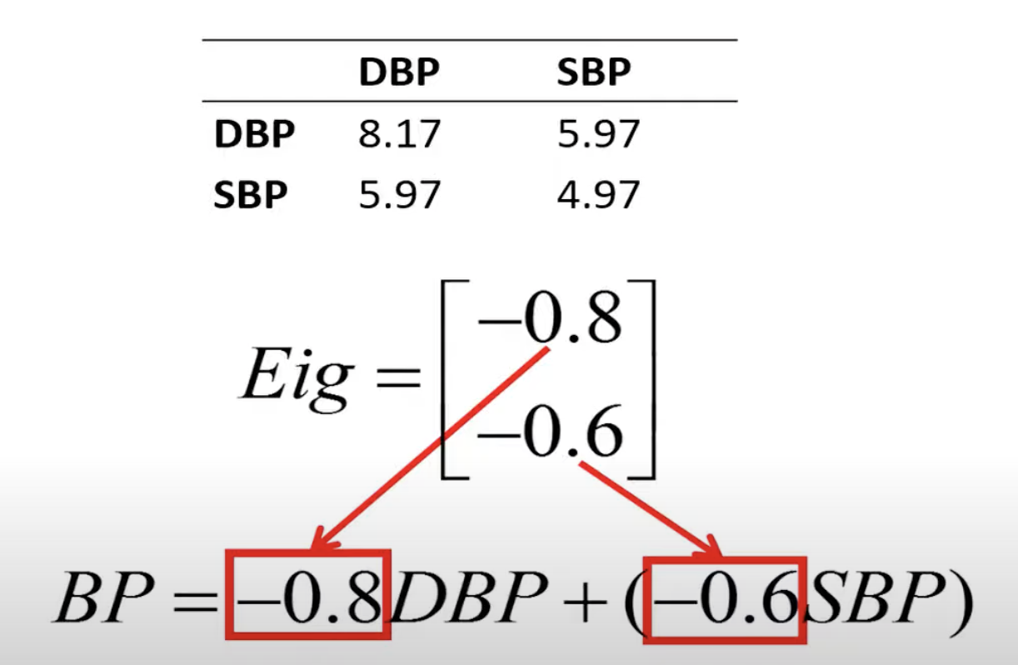
PCA
Diastolic BP | Systolic BP
78 | 126
80 | 128
81 | 127
82 | 130
84 | 130
86 | 132
Notes:
In this example, the PCA would first compute the following covariance matrix. This covariance matrix has been computed on the following data. Then it would compute the two eigenvectors of the covariance matrix. The eigenvector with the largest eigenvalue holds the values of the weights, which in this case are -0.8 and -0.6. The values in the first eigenvector are used as weights to combine the two variables. Although the weights are negative in this case, we will get the same variance as if they would have been positive as in the previous example.
12:27

Slide 13
PCA
Example 1
Diastolic BP | Systolic BP | Weight | Height
78 | 126 | 67 | 170
80 | 128 | 77 | 177
81 | 127 | 89 | 183
82 | 130 | 90 | 187
84 | 130 | 50 | 165
86 | 132 | 55 | 164
BP |  | BS
Cholesterol = BP + BS
Notes:
Now we have a look at some examples where PCA is used to analyze biological data.
PCA can be used to reduce the number of dimensions or variables in our dataset for further types of analysis. We see how to reduce the following 4 variables into just 2 variables.
The dataset measured the diastolic and systolic blood pressure of 6 individuals as well as their body weight in kilos and body height in centimeters. For example, we could use PCA to combine 4 variables of the last row into 2 variables. If the diastolic and systolic blood pressure show a strong correlation, we could combine them into just 1 variable we call blood pressure and if weight and height show a strong correlation, we could combine them into a variable that we call body size. If we would use these variables to predict, for example, the cholesterol level with linear regression, we could use only two explanatory variables, the blood pressure and the body size.

Slide 14
PCA
Example 2
Person | DBP | SBP | BMI | Chol. | Pulse | Temp | …
1 | 78 | 126 | 25 | 170 | 55 | 37.4 | …
2 | 80 | 128 | 27 | 177 | 56 | 37.8 | …
3 | 81 | 127 | 23 | 183 | 60 | 36.8 | …
4 | 82 | 130 | 30 | 187 | 61 | 36.4 | …
5 | 84 | 130 | 28 | 165 | 62 | 36.9 | …
6 | 86 | 132 | 35 | 164 | 70 | 37 | …
… | … | … | … | … | … | … | …
Combine into 2 variables
Person | PC1 | PC2
1 | 3.4 | 4.5
2 | 3.7 | 4.4
3 | -21.2 | -15.2
4 | -20.2 | -16.5
5 | -8.2 | -8.9
6 | -0.2 | 10.2
… | … | …
Notes:
Let’s say that we have measured many clinical variables on many individuals. We like to identify people that have a similar health profile, which means that they have about the same values of the clinical variables that have been measured. For example, the health profile of person number 1 more similar to the health profile of person number 2 compared to person number 3? When we have many variables, it is very difficult to manually identify person with a similar health profile.
If we combine all the variables into just 2 variables, that are called PC1 and PC2, it will be lot of easier to identify 2 individuals who have a similar health profile since we need to study 2 variables instead of many variables. When we combine variables with PCA, we will get these kinds of scores that are centered around 0, which explains why about half of values are negative.
If we combine all variables into just 2 variables, we can see that these 2 people have similar health profile, they have similar principal components, whereas person 3 and person 4 also have similar health profile but different from person 1 and person 2

Slide 15
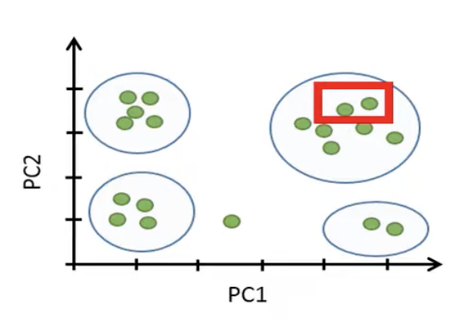
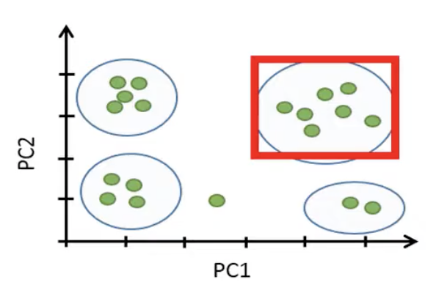
PCA
Example 2
Notes:
If we plot these principal components scores in a two-dimensional plot like this, each point will represent the combined healthy profile of each individual. Since these two individuals are close in this plot, this suggests that these 2 individuals have a similar health profile relative to the other variables.
We have identified 7 individuals that seem to have a distinct health profile compared to the other individuals.

Slide 16
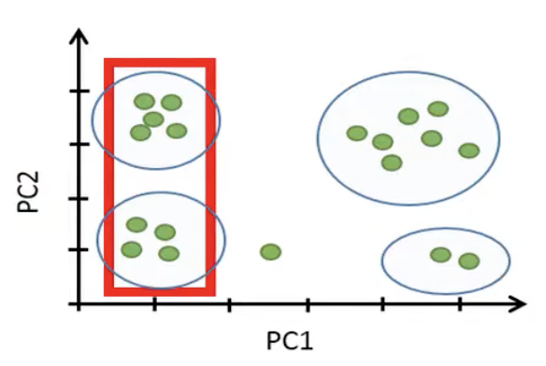
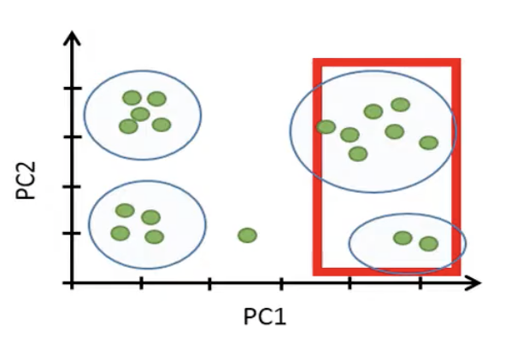
PCA
Example 2
Have similar health profile since these individuals have the same values of the variables associated with the health.
These individuals have a different health profile.
Notes:
Suppose that PC1 is mainly associated with the health whereas PC2 is associated with variables that generally differ between men and women.

Slide 17
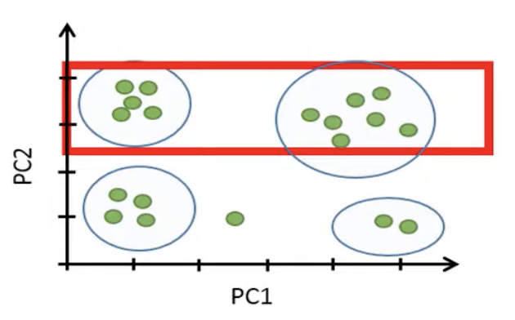
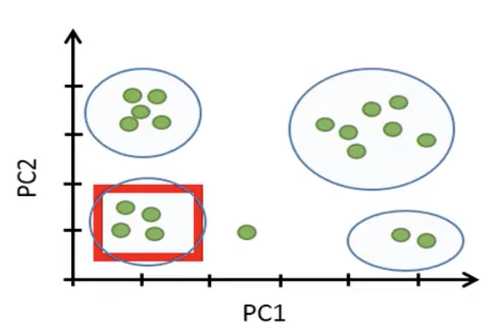
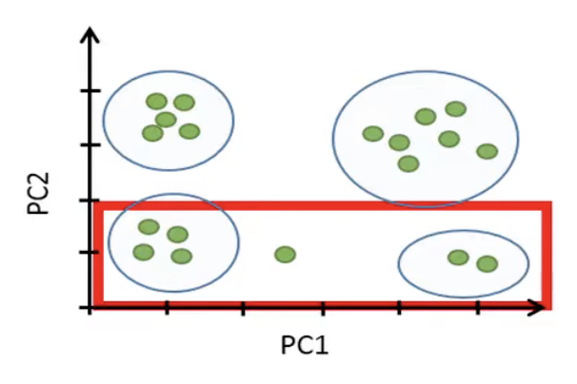
PCA
Example 2
These points represent men
These points represent four women have similar health profile
These points represent women
Notes:
PC2 is associated with variables that differ mainly between men and women

Slide 18
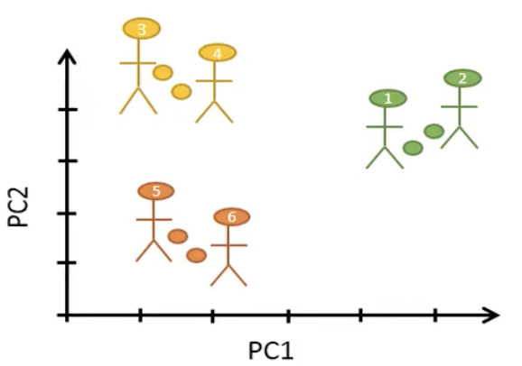
PCA
Example 3
Person | PC1 | PC2
1 | 8 | 2
2 | 9 | 3
3 | -5 | 11
4 | -4 | 10
5 | -5 | -12
6 | -3 | -14
Notes:
Another example where PCA is commonly used in biology is when we have measured the gene expression of all the genes. We have information on the gene expression of thousands of genes from a certain cell type extracted from each individual. For example, in this case we have information of the expression of thousands of genes for each of six persons. We see that Gene 3 is not expressed in none of the samples from the 6 individuals whereas Gene 4 is highly expressed. Since we have thousands of genes, it would be very difficult to identify 2 persons with a similar gene expression. In other words, it will be difficult to identify two persons with a similar gene expression profile. However, if we combine the expression of all genes into just 2 variables, PC1 and PC2, it will become a lot easier to identify persons with a similar gene expression profile.
We see that the principal component scores for person number 1 and 2 are similar, which suggest that these two people have similar gene expression profile. If we plot these scores in a 2-dimentional plot, it becomes even easier to identify 2 individuals similar scores

Slide 19
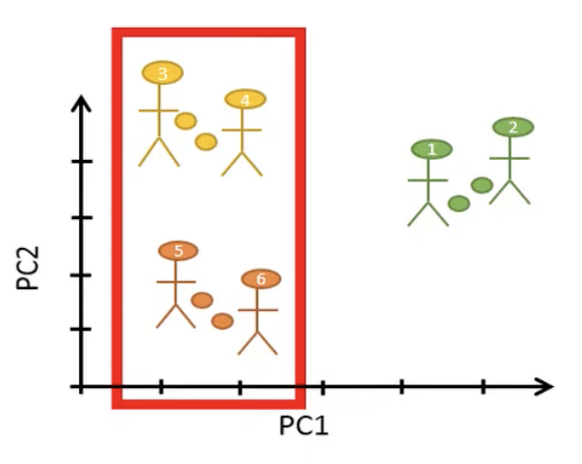
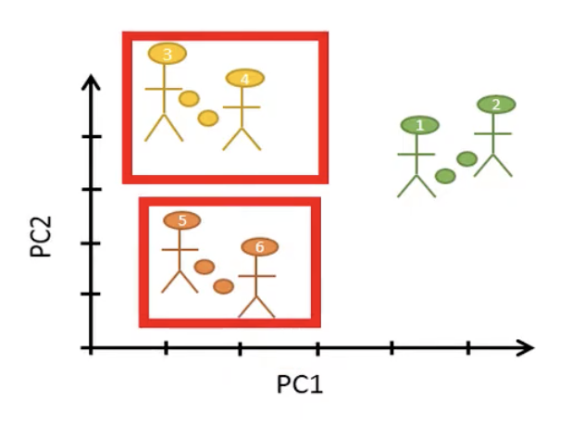
PCA
Example 3
Notes:
These 4 people have similar scores for PC1, but they are separated if we study PC2

Slide 20
PCA
Example 4
Cell | Gene 1 | Gene 2 | Gene 3 | Gene 4 | …
Cell 1 | 0 | 20 | 5 | 0 | …
Cell 2 | 10 | 0 | 56 | 0 | …
Cell 3 | 15 | 0 | 20 | 0 | …
Cell 4 | 10 | 13 | 13 | 0 | …
Cell 5 | 42 | 55 | 60 | 0 | …
Cell 6 | 0 | 0 | 30 | 0 | …
… | … | … | … | … | …
Cell | PC1 | PC2
Cell 1 | 5 | 22
Cell 2 | -10 | 0
Cell 3 | -3 | 13
Cell 4 | -3 | 13
Cell 5 | 19 | 55
Cell 6 | -7 | -7
… | … | …
Notes:
Another example, we have data from single-cell RNA-seq, where the gene expression of each extracted cell has been measured from just 1 person. For example, row 1 shows the expression of all the genes in cell 1 whereas row 2 shows the expression of all genes in cell 2. Gene 4 column is not expressed in the first 6 cells. The aim of these types of studies is usually to identify cells that have similar gene expression as such cells might represent a unique cell type or cells that undergo a certain biological process. However, this kind of dataset has thousands of columns and rows. To manually identify a group of cells that have similar gene expression profile would be almost impossible. If we reduce the number of columns to just 2, it will be easier to identify cells with a similar gene expression profile.

Slide 21
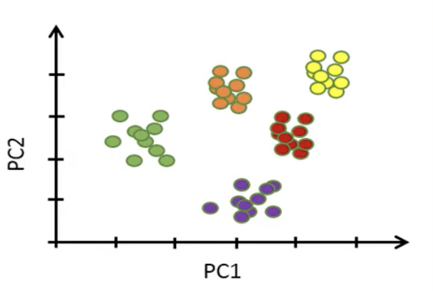
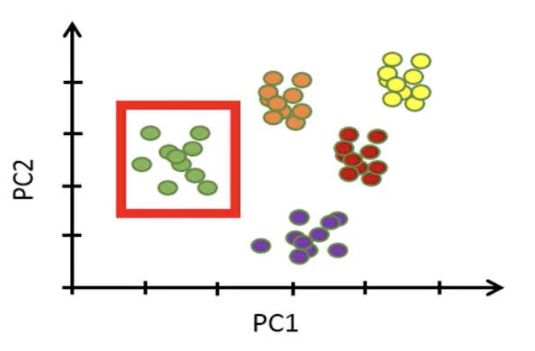
PCA
Example 4
Having 50 points represent 50 cells
Cells can be found in a distinct cluster
Notes:
If we plot these 2 principal components in a two-dimensional plot, will be easy to identify cells with similar gene expressions.

Slide 22
Reference
Tilevik, A. (n.d.) PCA1: Basics – simply explained. Available online: https://www.youtube.com/watch?v=dz8imS1vwIM&t=3s

